Slide 1
Activity planning
Module II

Slide 2
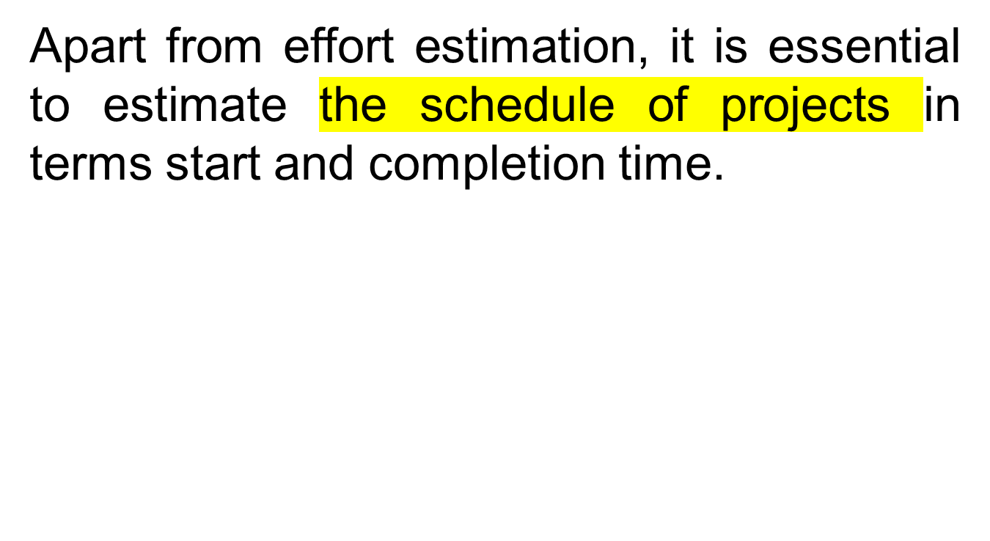
Introduction

Slide 3
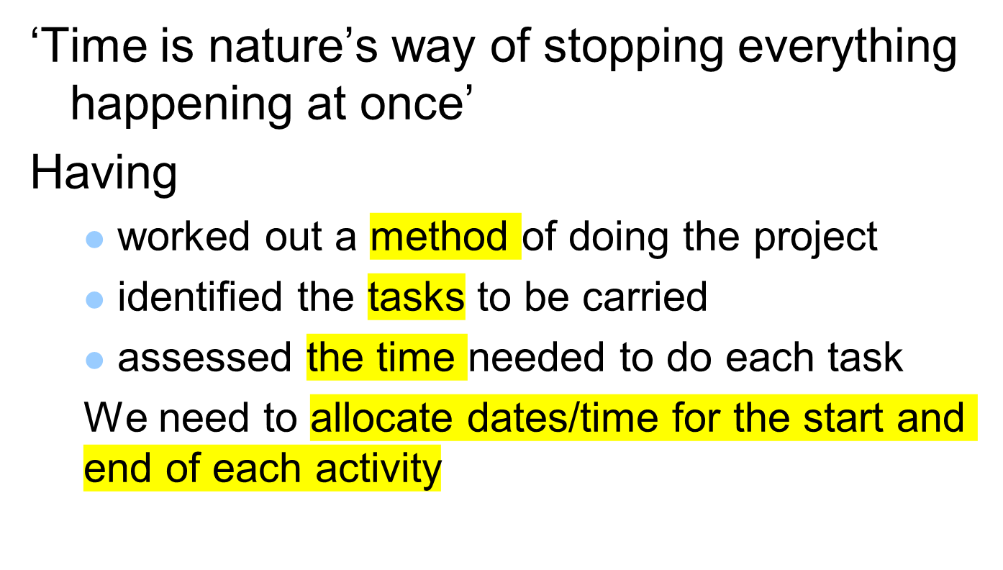
Activity Planning
Notes:
Point out to students (if you are in the United Kingdom at least) that the UK English pronunciation of schedule is ‘shedule’ and that ‘skedule’ is the US pronunciation!

Slide 4
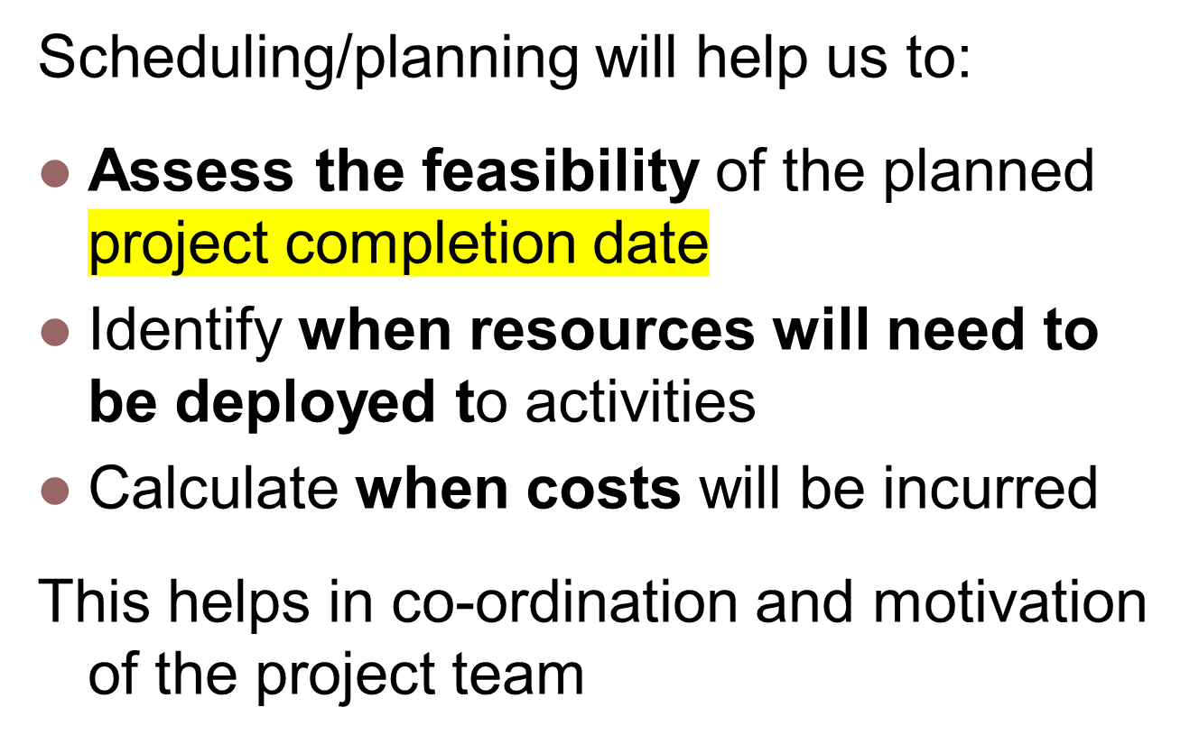
Notes:
Section 6.2 of the textbook discusses this

Slide 5
Objectives of Activity Planning
Feasibility Assessment – timescales & resource constraint
Is the project possible within the required timescale and resources constraints
Resource allocation: –when it needs to be allocated
  To ensure the availability of resources when required
  To avoid different activities competing for same resources at the same time

Slide 6
Objectives of Activity Planning
Detailed costing - expenditure
Produce a timed cash flow forecast;
when and how much will the project cost?
Produce detailed schedule showing which staff to carry out each activity

Slide 7
Objectives of Activity Planning
Motivation: Providing targets and monitoring achievement
  Produce detailed plan against which actual achievement may be measured
Coordination: Effective communication and coordination among teams.
  Replan the project during its life to correct drift from the target.

Slide 8
When to Plan
Planning is an ongoing process of refinement
Helps estimate timescales and risks
Keeping within the budget
Each iteration becoming more detailed and more accurate than the previous.
Over successive iterations, the emphasis and purpose of planning will shift.
Monitoring and replanning might correct any drift in terms of cost and time.

Slide 9
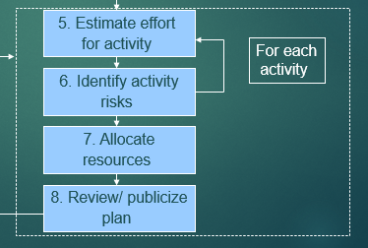
Project Schedule
When planning evolves with start and end date, it evolves as a project schedule.
Ideal activity plan
Activity risk analysis
Resource allocation
Schedule &Publicize
project

Slide 10
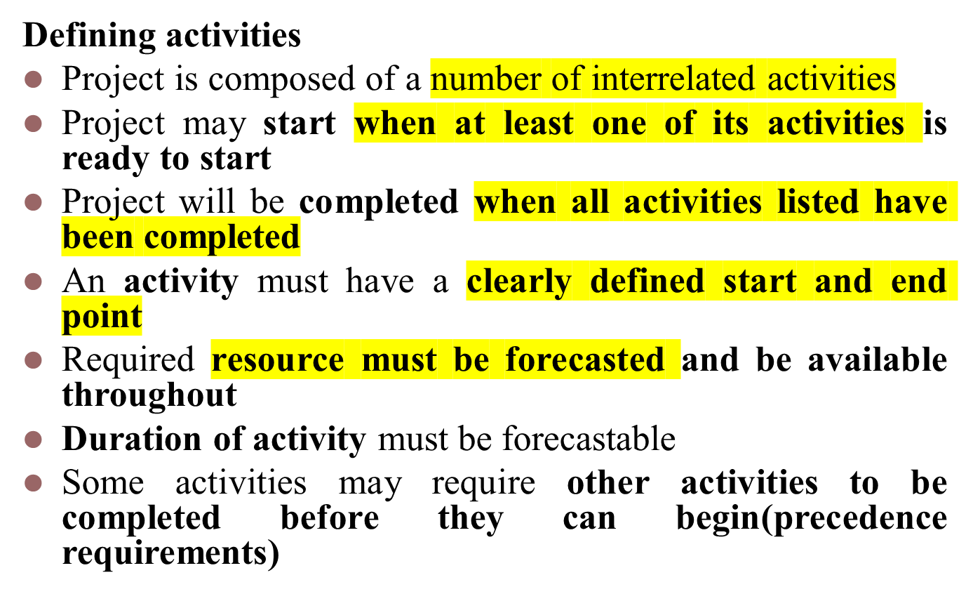
Projects and Activities

Slide 11
Identifying the activities
  Three approaches to identifying activities or tasks
  The activity based / Work based approach
  The product based approach
  The hybrid approach

Slide 12
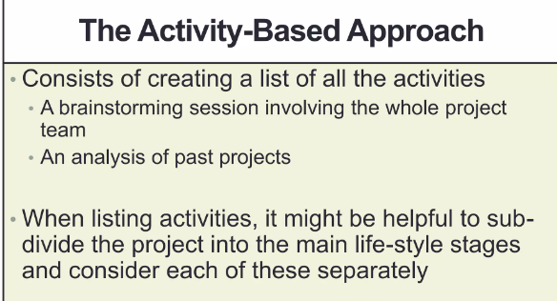

Slide 13
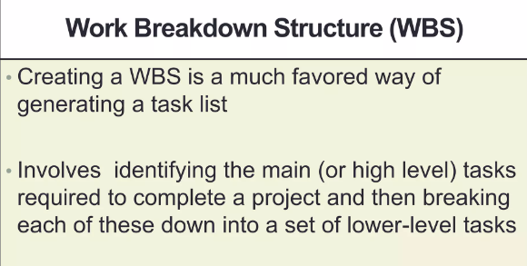

Slide 14
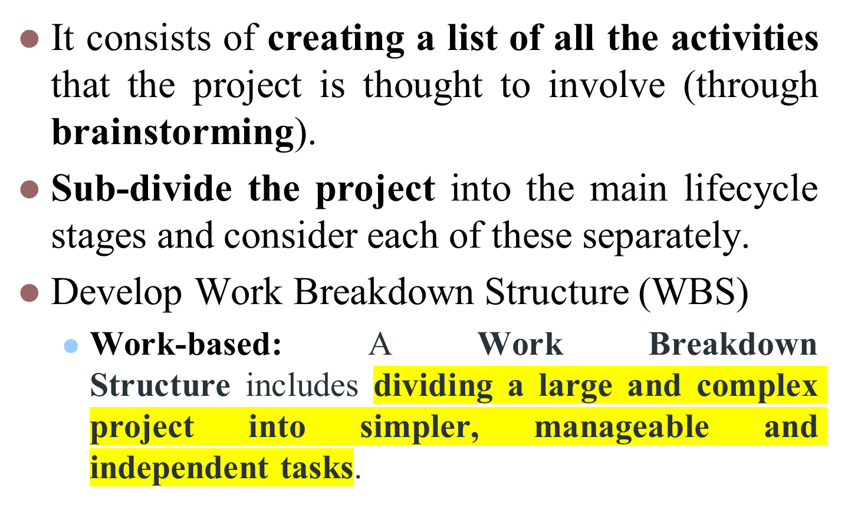
The activity based structure

Slide 15

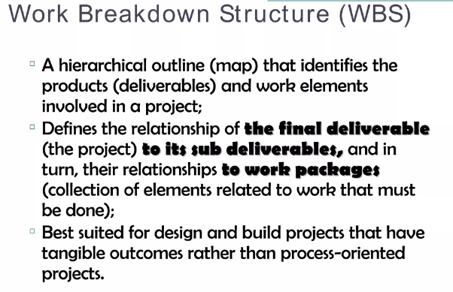

Slide 16
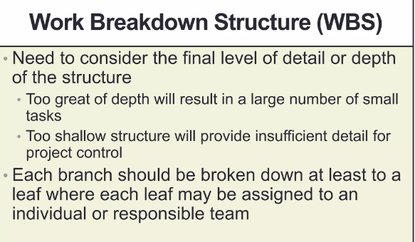

Slide 17
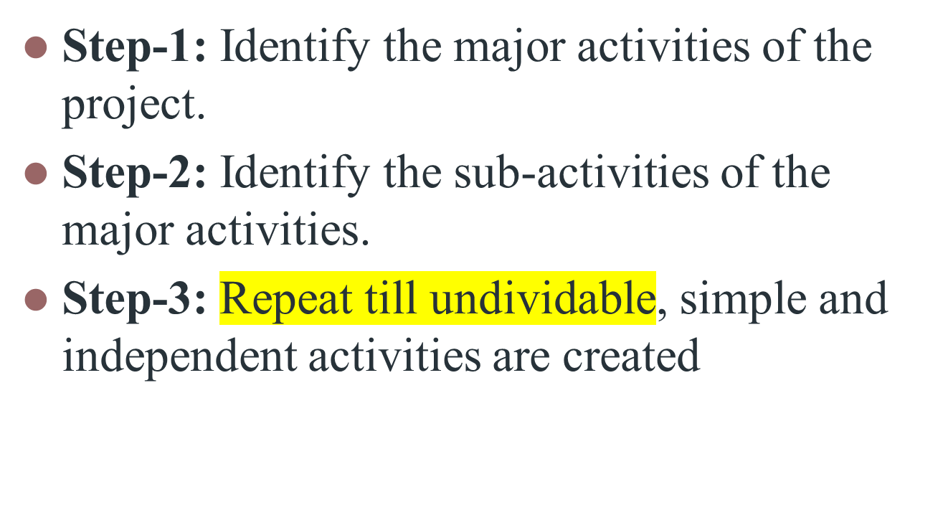
Steps

Slide 18
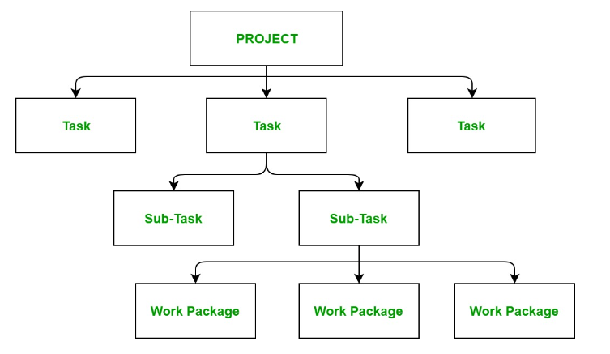

Slide 19
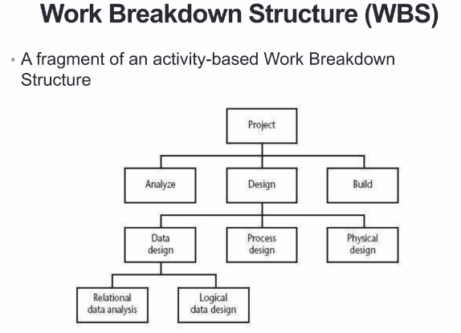
Fragment of activity based WBS

Slide 20
Advantages
Results in a complete task catalogue with non-overlapping activities
Leaves comprise the list of activities of the project
Helps sequence the activities

Slide 21
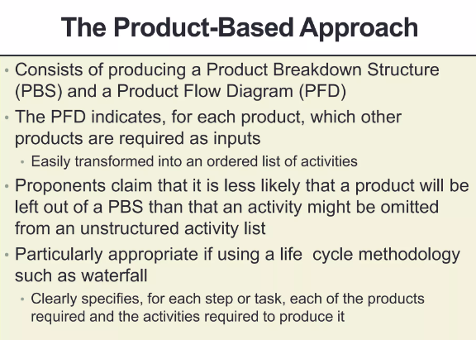

Slide 22
The product based structure
It consists of producing a Product Breakdown Structure and a Product Flow Diagram(PDF).
PDF indicates for each product, which other products are required as input.
Product-based approach
  List the deliverable and intermediate products of project – product breakdown structure (PBS)
  Identify the order in which products have to be created
  Work out the activities needed to create the products

Slide 23
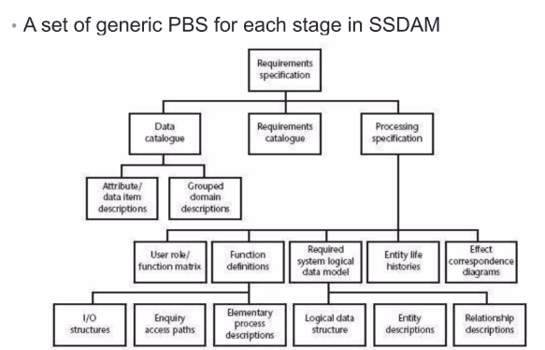
Structured System analysis and Design Method

Slide 24
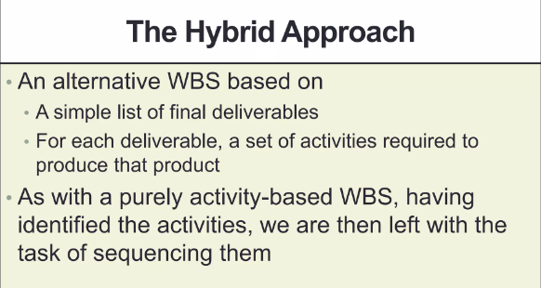

Slide 25
The hybrid approach
Products and a set of activities to produce that product (based on deliverables).
Five levels
  Project
  Deliverables
  Components
  Work package
  Tasks

Slide 26
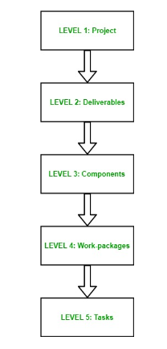

Slide 27
The IBM approach suggested the following 5 levels
Level 1: Project
Level 2: Deliverables
Level 3: Components – which are key work items needed to produce the deliverables
Level 4: Work packages: groups of tasks needed to produce the components
Level 5: Tasks (responsibility of individuals / single person)

Slide 28
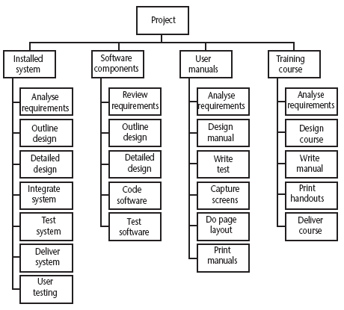
Hybrid approach
A Work Breakdown Structure based on deliverables
Notes:
The IBM MITP approach suggested the following 5 levels
Level 1: Project
Level 2: Deliverables
Level 3: Components – which are key work items needed to produce the deliverables
Level 4: Work packages: groups of tasks needed to produce the components
Level 5: Tasks

Slide 29
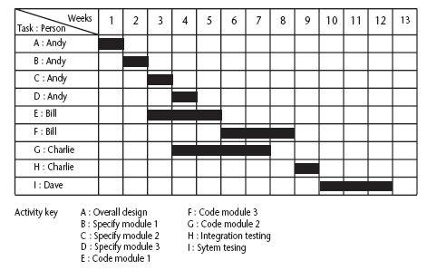
The final outcome of the planning process
A project plan as a bar chart. (The chart tells us who is doing what and when. )
Notes:
The chart tells us who is doing what and when.

Slide 30
Network Planning Models
Models the project activities and their relationships as a network.
  Two Methods:
  PERT – Program Evaluation Review Technique / Precedence Networks (Activity on node (AON)-the ‘nodes’ are the boxes which represent activities)
  CPM – Critical Path Method (Activity on arrow (AOA) – ‘arrows’ are the activities).

Slide 31
PERT vs CPM
PERT is an activity-on-node notation
Do B
PERT
Do A
Do D
Do C
CPM
Do B
Do A
Do D
Do C
CPM uses an activity-on-arrow notation where the arrows are the activities
Notes:
PERT was devised to support the development of the Polaris missile in the late 1950’s. CPM was developed by Du Pont Chemical Company who published the method in 1958.
PERT is an activity-on-node notation – the ‘nodes’ are the boxes which represent activities
CPM uses an activity-on-arrow notation where the arrows are the activities.
The approach described here is based on PERT but the other approach is described in the textbook as well – see Section 6.16

Slide 32
PERT
PERT is a technique used for the projects where the time required to complete different activities are not known (uncertain activities).
PERT is majorly applied for planning, scheduling, organization and integration of different tasks within a project.
It provides the blueprint of project and is an efficient technique for project evaluation

Slide 33
Critical Path Method
CPM is a technique used for the projects where the time needed for completion of project is already known.(well defined activities)
It is majorly used for determining the approximate time within which a project can be completed.

Slide 34
Critical path represents the longest duration of every dependent task, to find the most efficient schedule while still accomplishing the goals needed for a successful project
Critical path is about choosing the largest path in project management which always provide minimum time taken to complete a project.

Slide 35
Both PERT and CPM used AoA initially and later Precedence network became popular which follows AON.

Slide 36
Formulating a Network Model
AON (Precedence diagram)
Represent the activities and their relationships as a graph.
Activities as nodes
Lines as dependencies

Slide 37
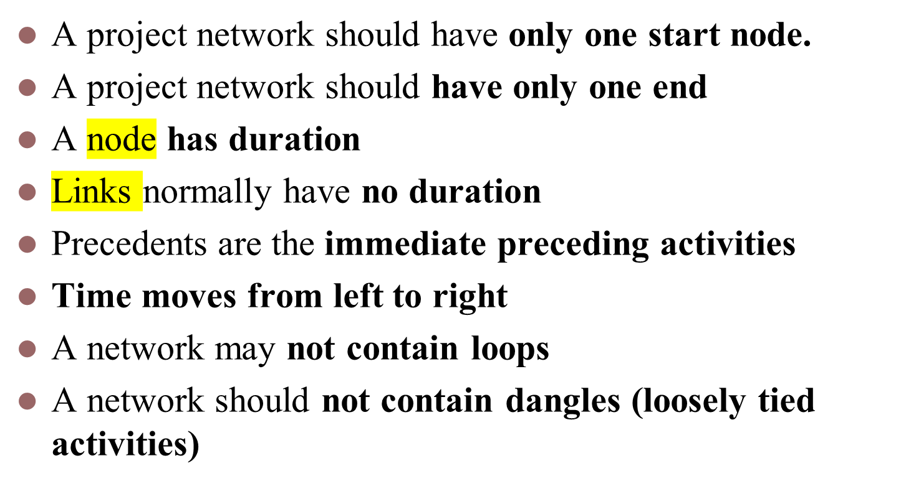
Rules - Constructing Precedence Networks

Slide 38
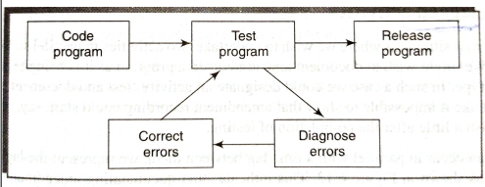
A loop represents an impossible sequence
Test- Diagnose-correct sequence: If we know the number of times this needs to be done, we can draw a sequence. Else, we cannot calculate the duration of the project

Slide 39
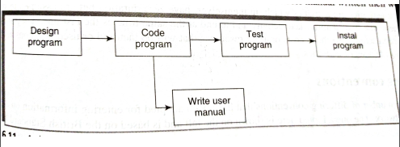
Dangle
Dangle: When an activity is disconnected before all activities in a network have been completed.
Leaving an activity incomplete

Slide 40
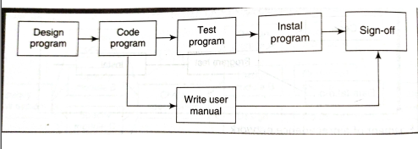
Resolving Dangle
There should be a logical end

Slide 41
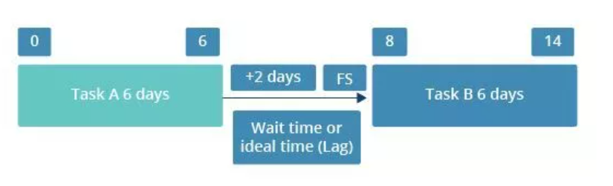
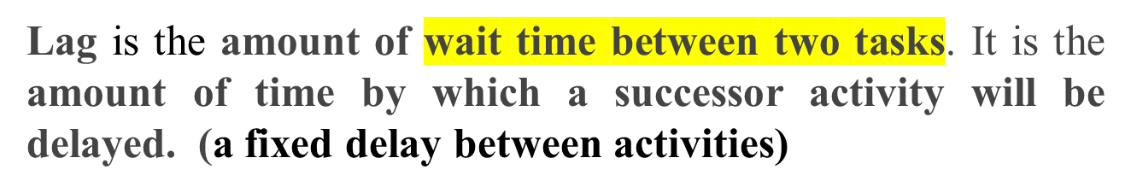
Lagged activities
Ideally both task A and B should get finished on the 12th day (6+6 days). But, when we insert a waiting of time of 2 days before B can start, then both A and B will get completed only on the 14th day.

Slide 42
Hammock activity
Hammock activity- group of tasks that float between start and end dates
(subtasks that needs to be completed before the end date)

Slide 43
Types of links between activities
Finish to start: The following activity starts when the previous one has been finished
e.g. testing starts when coding has been completed
Software
development
Acceptance testing
Notes:
Finish to start: The following activity starts when the previous one has been finished
e.g. testing starts when coding has been completed
Start to start: When one activity starts another has to start as well
e.g. when prototype testing starts amendment documentation has to start as well
Finish to finish: when one activity finishes the other must finish too
e.g. when the testing of the prototype is completed so is the documentation of any amendments
You could use these with lags e.g. documentation of the changes to the prototype starts 1 day after the testing and finishes 2 days after testing has been completed

Slide 44
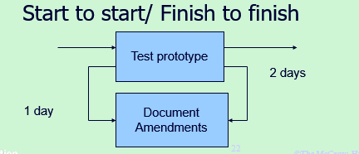
Start to Start: When one activity starts another has to start as well. e.g. when prototype testing starts amendment documentation has to start as well.

Slide 45
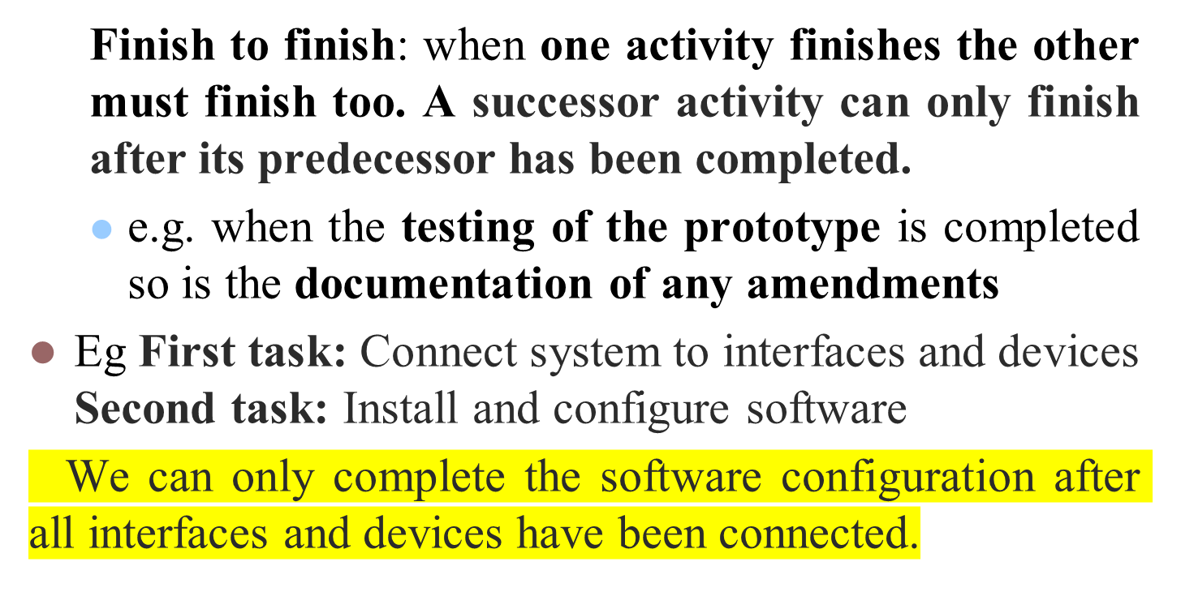

Slide 46
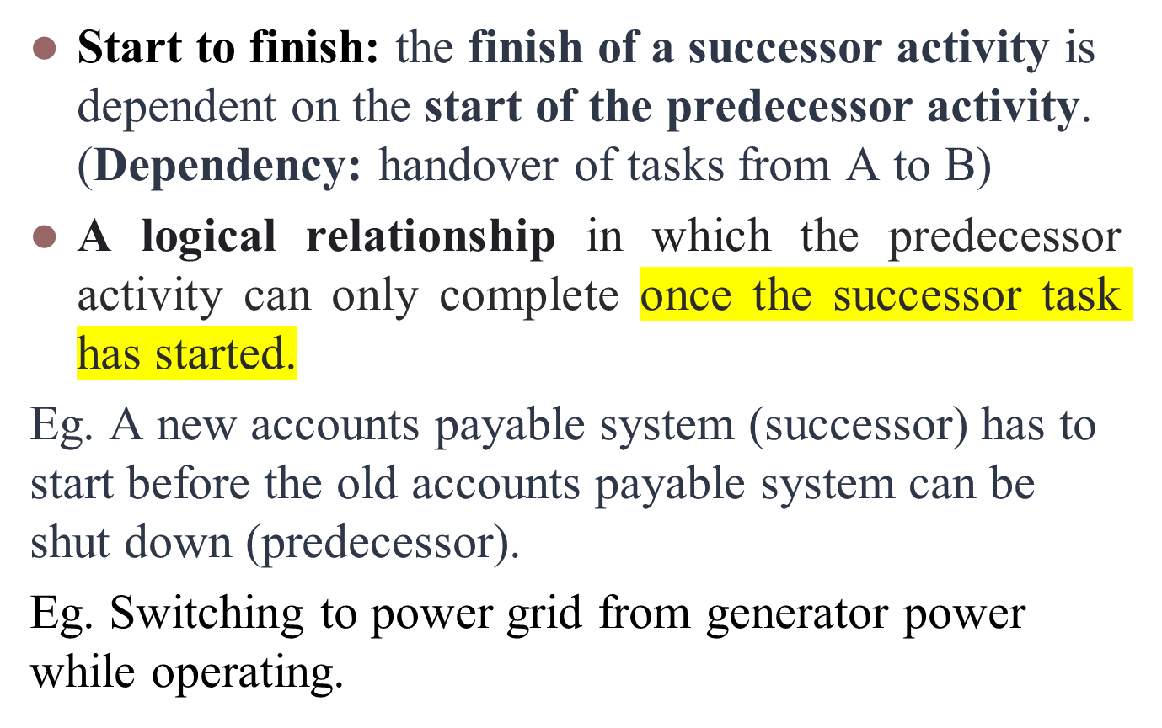

Slide 47
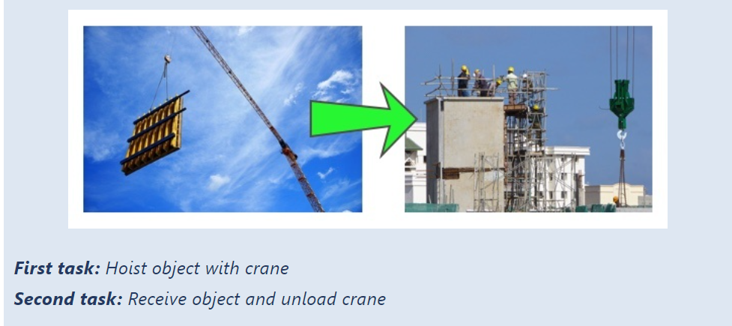
The first task, hoisting the object, can only be completed once team 2 is ready to receive the object (second task).

Slide 48
You can only deactivate the old system once the new system has been enabled and users can work with it.
When the cutover to the new system takes place, the operation of the temporary system is no longer needed.
Operate temporary
system
Cutover to new
system
Acceptance test
of new system
Notes:
Start to finish – in the example when the cutover to the new system takes place, the operation of the temporary system is no longer needed. Although the cutover depends of the acceptance testing to be completed, the implication is that the cutover might not start straight after acceptance testing.

Slide 49
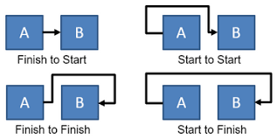

Slide 50
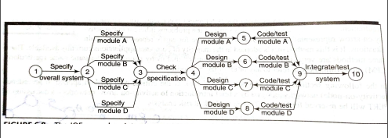

Slide 51
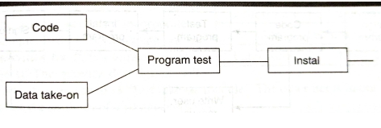
Fragment of precedence network
Installation cannot start until program testing is completed

Slide 52
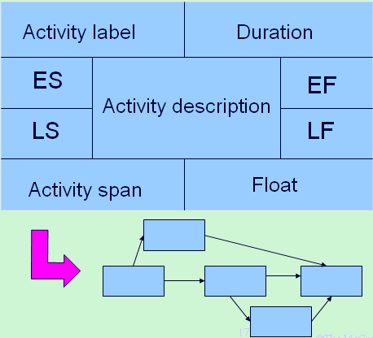
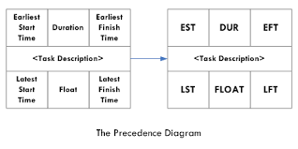
Constructing Precedence Networks (activity-on-node n/w)
Notation

Slide 53
Adding the Time Dimension
Adding Time Dimension
After creating the logical network model and the interrelationships between those activities, when each activity should be undertaken must be marked.
Each activity duration is estimated
Forward pass, Backward pass

Slide 54
The critical path approach
  Planning the project in such a way that it is completed as quickly as possible
  Identify the activities where a delay in their execution is likely to affect the overall end date of the project or later activities

Slide 55
Every task will have following set of start and finish time.
Earliest start time (ES) - The earliest time, an activity can start once the previous dependent activities are over. (earliest of the preceding activities upon which the current activity depends is completed, so that the current one can start).
Earliest finish time (EF) - This would be ES + activity duration.

Slide 56
Latest finish time (LF) - The latest time an activity/task can finish without delaying the project or without affecting the project end.
Latest start time (LS) = LF – duration of the activity.

Slide 57
Start and finish times
Latest finish
Earliest start
activity
Latest start
Earliest finish
Activity ‘write report software’
Notes:
The time that an activity can start depends on its relationship with the other tasks in the project. The earliest start is when the earliest of the preceding activities upon which the current activity depends will be completed, so that the current one can start. If it starts at this time the earliest the current activity can finish is the earliest start plus its duration.
However, it may be that the activity, although it can start, can be delayed because later activities do not have to start right way. This gives us a latest finish date. The latest start date is the latest finish date less the duration of the activity.
When a student is given coursework to do they do not necessarily start it straight away. They might note when it has got to be handed in, work out that it will only take about three days to do - with a bit of luck - and wait until three days before the hand-in before they start.

Slide 58
Earliest start date
Earliest start date for the current activity = earliest finish date for the previous
When there is more than one previous activity, take the latest earliest finish
Note ‘day 7’ = end of work on day 7
EF = day 7
ES = day10
EF = day10

Slide 59
Example
earliest start = day 5
latest finish = day 30
duration = 10 days
earliest finish =?
EF= ES + Duration =5+10= day15
latest start = ?
LS= LF- duration
= 30-10= day 20
The earliest finish (EF) would be day 5 plus 10 days i.e. day 15. (ES + Duration)
The latest start (LS) would be day 30 – 10 days i.e. day 20 (LF-duration)
Notes:
The earliest finish (EF) would be day 5 plus 10 days i.e. day 15.
The latest start (LS) would be day 30 – 10 days i.e. day 20
The float would be 30 – 5 – 10 = 15 days
This also is the same as LF – EF or LS - ES

Slide 60
A project specification with estimated activity durations and precedence requirements
Activity | Duration (weeks) | Precedents
A Hardware selection | 6
B Software design | 4
C Install hardware | 3 | A
D Code and test software | 4 | B
E File take-on | 3 | B
F Write user manuals | 10
G User training | 3 | E,F
H Install and test system | 2 | C,D

Slide 61
Precedence network/activity network
Work out the earliest start and end dates for each activity
A
6 wks
C
3 wks
Hardware
selection
Install
hardware
B
4 wks
D
4 wks
H
2 wks
Start
Software
design
Code
software
Install and
test
Finish
F
10 wks
E
3 wks
G
3 wks
User
manual
File
Take-on
User
training

Slide 62
Activity ES duration EF
A 0 6 6
B 0 4 4
C 6 3 9
D 4 4 8
E 4 3 7
F 0 10 10
G 10 3 13
H 9 2 11

Slide 63
The forward pass – to calculate earliest date on which each activity may be started and completed
By convention, dates indicate the end of a period. The project is shown as starting at the end of week 0 (or the beginning of week 1)
A
6 wks
C
3 wks
0
Hardware
selection
6
6
Install
hardware
9
B
4 wks
D
4 wks
H
2 wks
Start
0
Software
design
4
4
Code
software
8
9
Install and
test
11
Finish
F
10 wks
E
3 wks
G
3 wks
0
User
manual
10
4
File
Take-on
7
10
User
training
13

Slide 64
The backward pass – to calculate latest date at which each activity may be started and completed without delaying the end date of the project
Assumption – latest finish date for the project is the same as the earliest finish date – we wish to complete the project as early as possible.
A
6 wks
C
3 wks
0
Hardware
selection
6
6
Install
hardware
9
2
8
8
11
B
4 wks
D
4 wks
H
2 wks
Start
0
Software
design
4
4
Code
software
8
9
Install and
test
11
Finish
3
7
7
11
11
13
F
10 wks
E
3 wks
G
3 wks
0
User
manual
10
4
File
Take-on
7
10
User
training
13
0
10
7
10
10
13

Slide 65
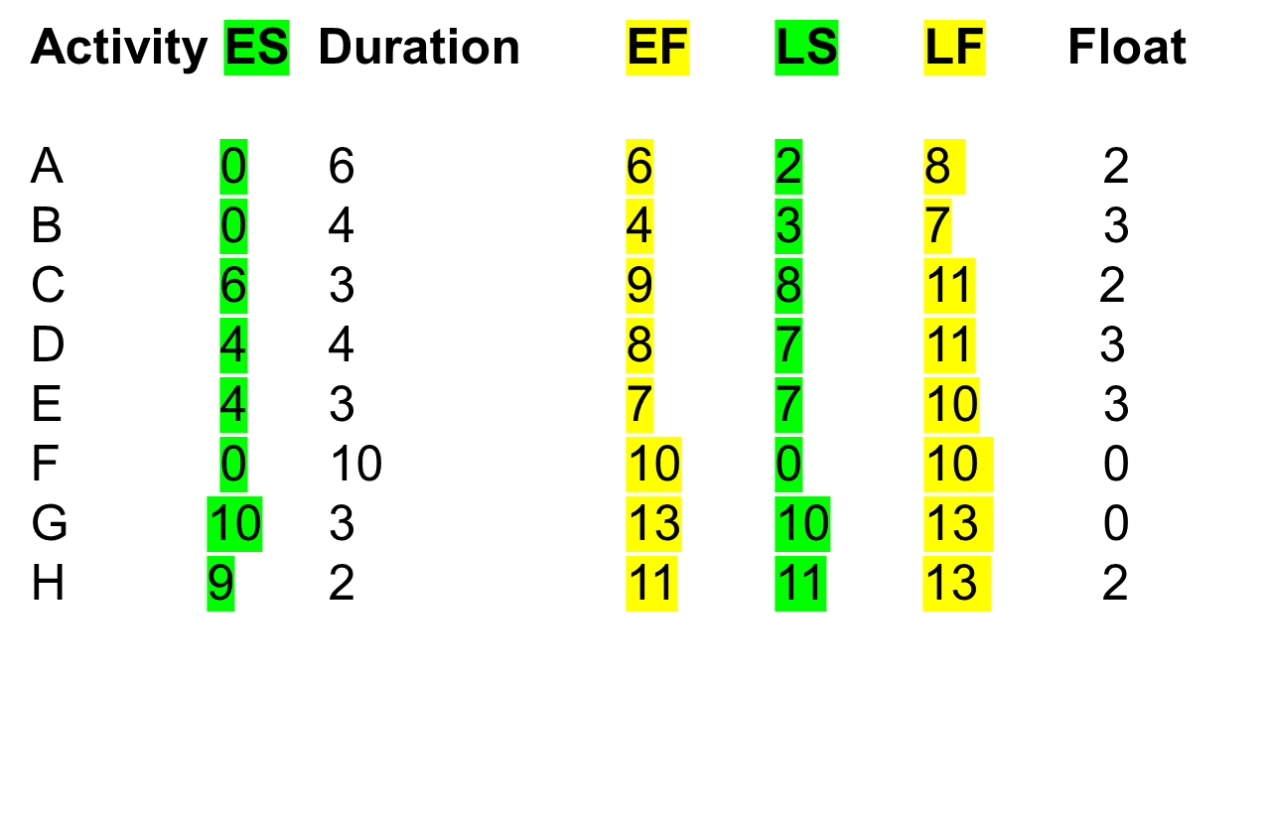

Slide 66
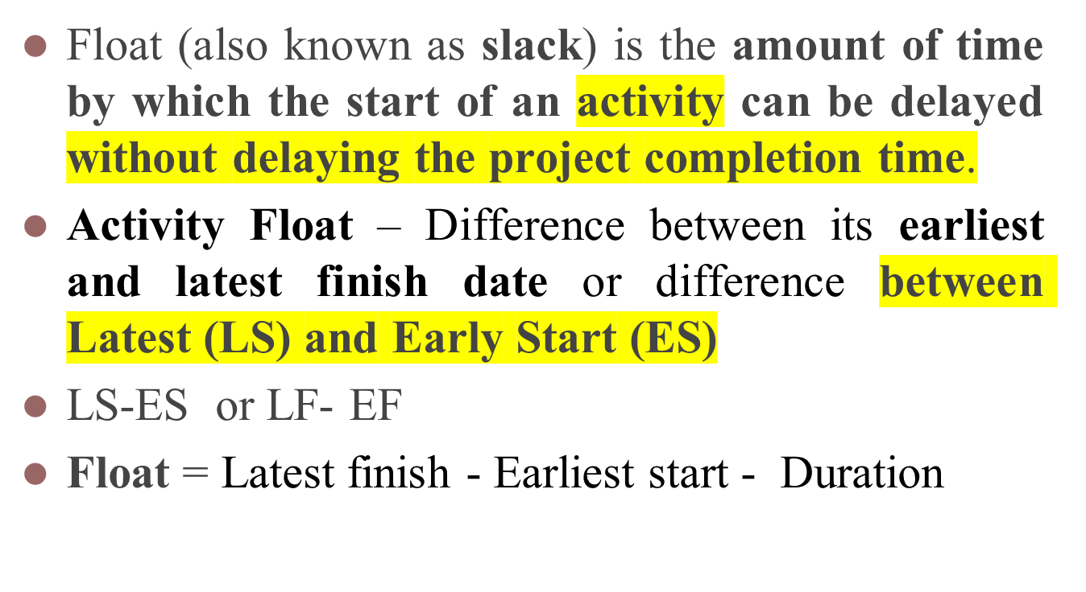
FLOAT

Slide 67

Float
Float = Latest finish - Earliest start - Duration
Or
Float = ES - LS
Float = EF - LF
FLOAT
LF
ES
activity
Latest start
Earliest Finish
Notes:
Note that Float can also be calculated as the difference between the earliest and latest start dates for an activity or the difference between the earliest and latest finish dates.

Slide 68
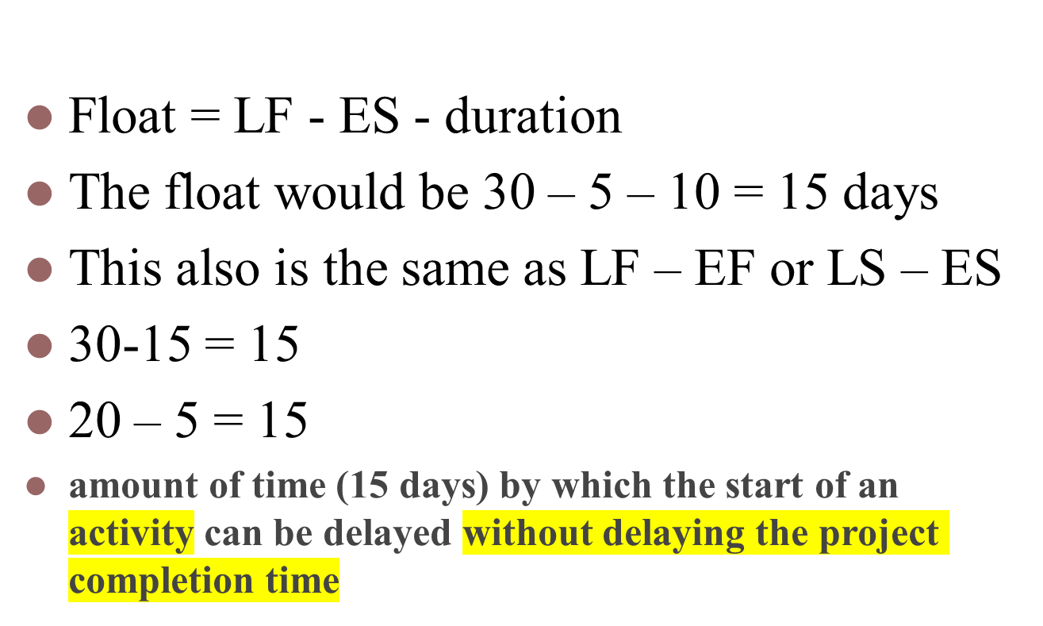
FLOAT - What is it in this case?

Slide 69
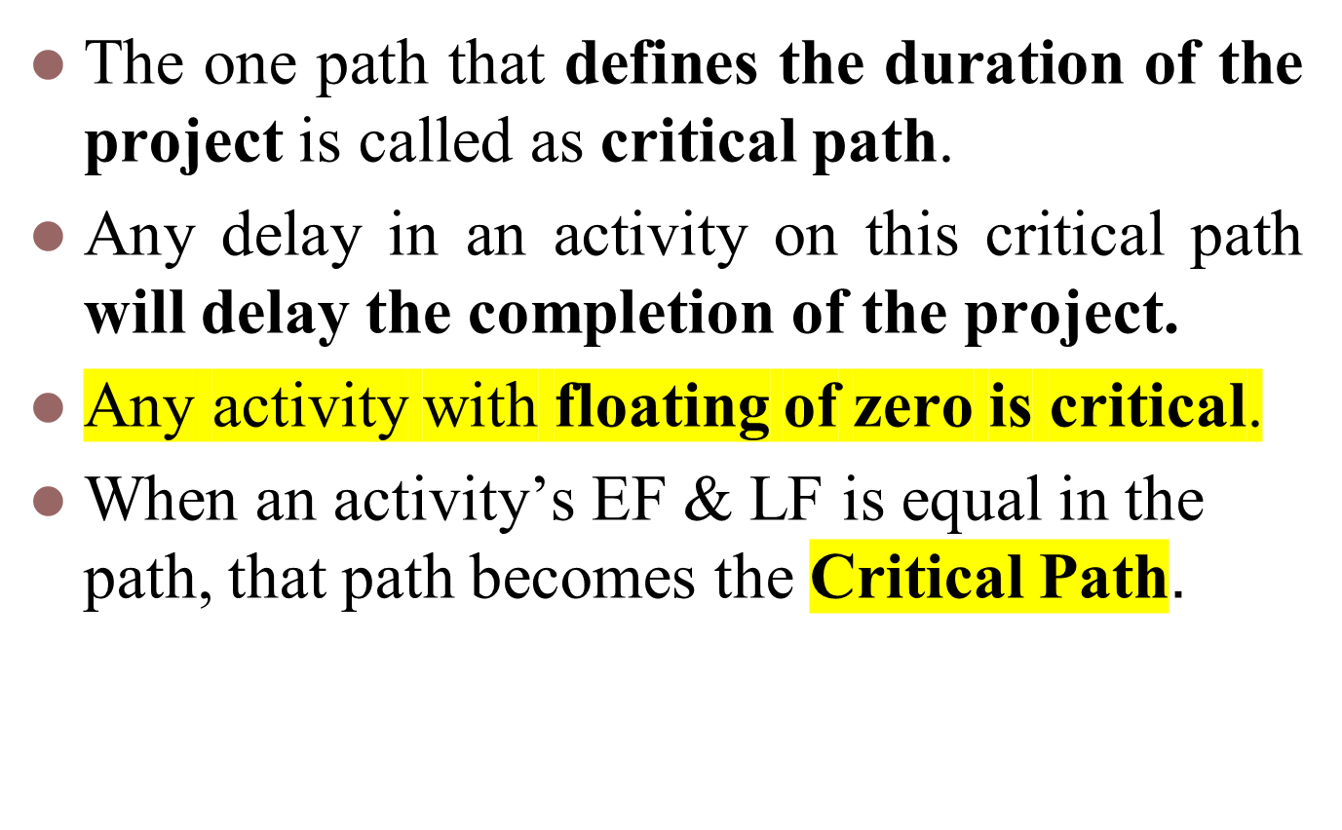
Identifying Critical Path

Slide 70
Identifying near Critical Path
Activities that are not in the critical path may also become critical in due course.
Hence, identifying near critical path is good practice

Slide 71
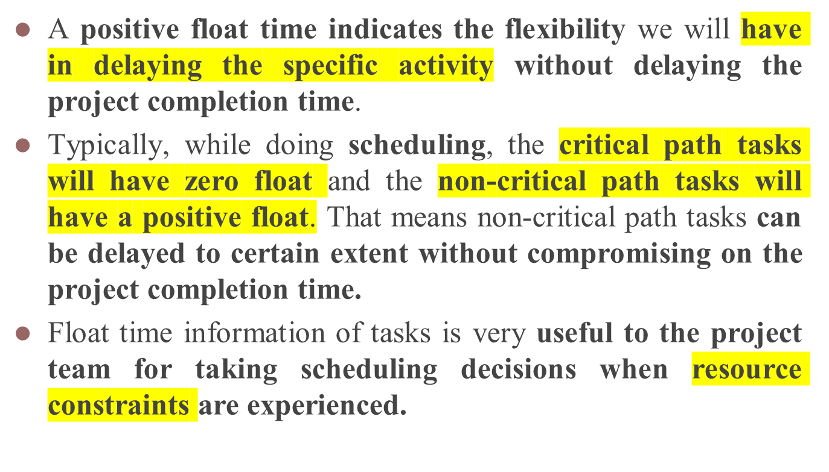

Slide 72
Float = Difference (ES – LS) or (EF – LF) or (LF – ES – Duration)
A
6 wks
C
3 wks
0
Hardware
selection
6
6
Install
hardware
9
2
8
8
11
2 wks
2 wks
B
4 wks
D
4 wks
H
2 wks
Start
0
Software
design
4
4
Code
software
8
9
Install and
test
11
Finish
3
7
7
11
11
13
3 wks
3 wks
2 wks
F
10 wks
E
3 wks
G
3 wks
0
User
manual
10
4
File
Take-on
7
10
User
training
13
0
10
7
10
10
13
0 wks
3 wks
0 wks

Slide 73
Activity Span = LF - ES
Activity Span: Maximum time allowable for each activity
A
6 wks
C
3 wks
0
Hardware
selection
6
6
Install
hardware
9
2
8
8
11
8 wks
2 wks
5 wks
2 wks
B
4 wks
D
4 wks
H
2 wks
Start
0
Software
design
4
4
Code
software
8
9
Install and
test
11
Finish
3
7
7
11
11
13
7 wks
3 wks
7 wks
3 wks
4 wks
2 wks
F
10 wks
E
3 wks
G
3 wks
0
User
manual
10
4
File
Take-on
7
10
User
training
13
0
10
7
10
10
13
10 wks
0 wks
6 wks
3 wks
3 wks
0 wks

Slide 74
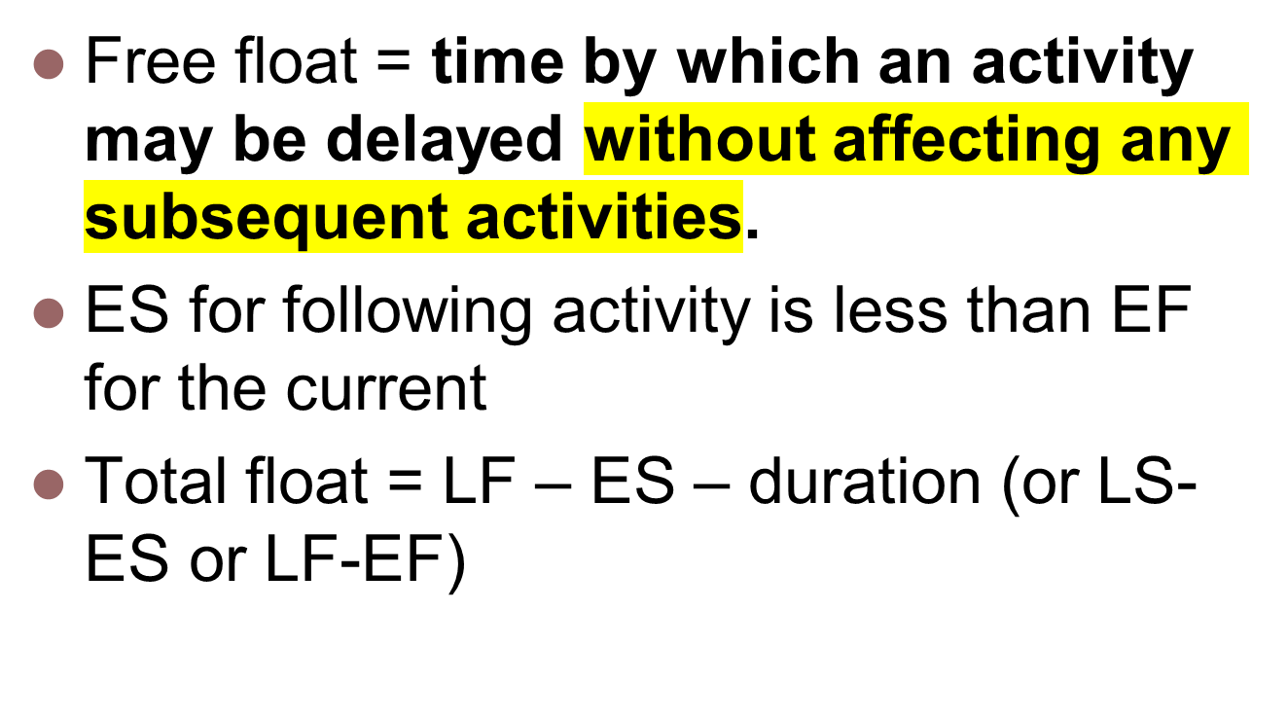

Slide 75
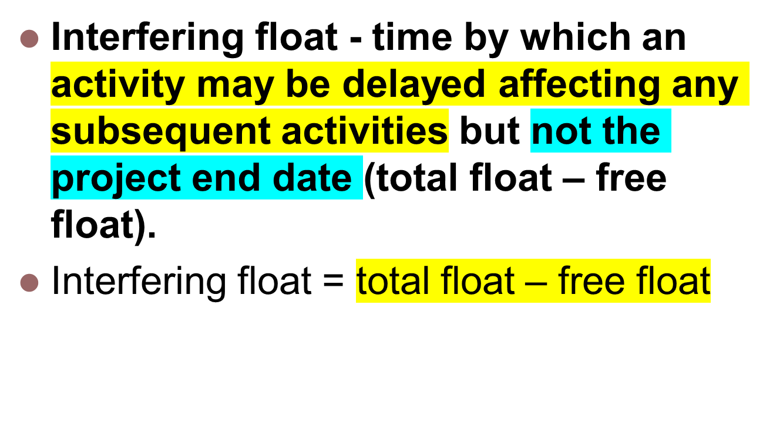

Slide 76
Free float Vs Interfering float
Free float – time by which an activity may be delayed without affecting any subsequent activities.
Interfering float - time by which an activity may be delayed affecting any subsequent activities but not the project end date (total float – free float).
D can be 1 wk late and not affect any other activity = free float
A
6 wks
C
3 wks
0
Hardware
selection
6
6
Install
hardware
9
D can be further 2wk late . It affects H but not the project end date = Interfering float
2
8
8
11
2 wks
2 wks
B
4 wks
D
4 wks
H
2 wks
Start
0
Software
design
4
4
Code
software
8
9
Install and
test
11
Finish
3
7
7
11
11
13
3 wks
3 wks
2 wks
F
10 wks
E
3 wks
G
3 wks
0
User
manual
10
4
File
Take-on
7
10
User
training
13
0
10
7
10
10
13
0 wks
3 wks
0 wks

Slide 77
Eg. Free and interfering float
A
7w
0
B can be up to 3 days late
and not affect any
other activity = free float
7
2
9
2
B
4w
D
1w
E
2w
0
4
7
8
10
12
5
9
9
10
10
12
5
2
0
C
10w
0
10
0
10
B can be a further 2 days late – affects
D but not the project end date =
interfering float
0
Notes:
Total float = LF – ES – duration (or LS-ES or LF-EF)
Free float = ES for following activity less EF for the current
Interfering float = total float – free float

Slide 78
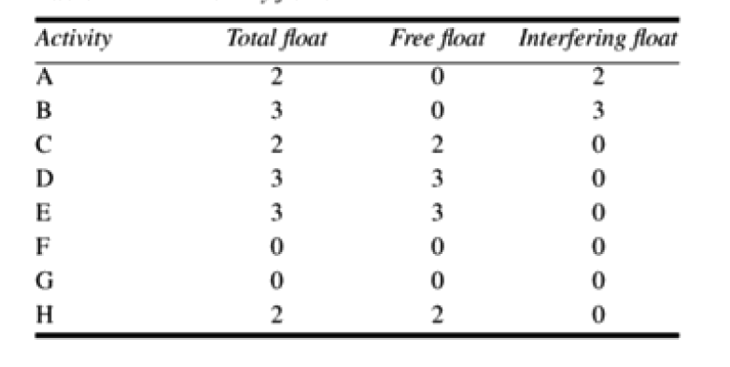

Slide 79
Activity Span = LF - ES
A
6 wks
C
3 wks
0
Hardware
selection
6
6
Install
hardware
9
2
8
8
11
8 wks
2 wks
5 wks
2 wks
B
4 wks
D
4 wks
H
2 wks
Start
0
Software
design
4
4
Code
software
8
9
Install and
test
11
Finish
3
7
7
11
11
13
7 wks
3 wks
7 wks
3 wks
4 wks
2 wks
F
10 wks
E
3 wks
G
3 wks
0
User
manual
10
4
File
Take-on
7
10
User
training
13
0
10
7
10
10
13
10 wks
0 wks
6 wks
3 wks
3 wks
0 wks

Slide 80
Shortening the Project Duration
Consider attempting to reduce activity durations
Generally time savings are to be found by increasing the amount of parallelism in the network and the removal of bottlenecks.

Slide 81
Critical path
Can there be more than one critical path?
Yes, there could be more than one critical path if the two longest paths through the network were of equal length.
Sub-critical paths :Sub-critical paths are chains of activities, not on the planned critical path, but which have small floats and which could easily become the critical path as the project develops.
Notes:
Yes, there could be more than one critical path if the two longest paths through the network were of equal length.
Where the target completion date for the project was imposed rather than calculated from the earliest finish dates, it might be later that the earliest finish date. In this case there would be no chains of activities with zero floats
The durations of activities are only estimates to start with. As the project proceeds, the estimates will be replaced by actual durations which could be different. This could change the sequence of activities identified as the critical path. Sub-critical paths are chains of activities, not on the planned critical path, but which have small floats and which could easily become the critical path as the project develops.

Slide 82
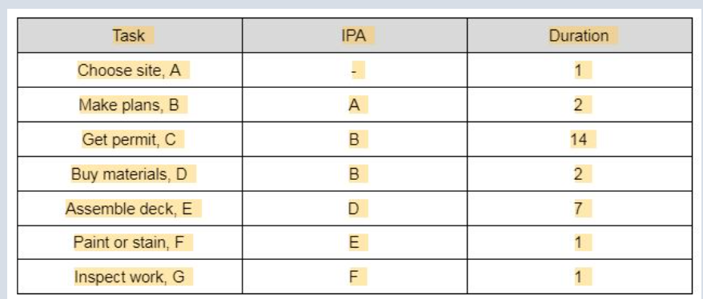

Slide 83
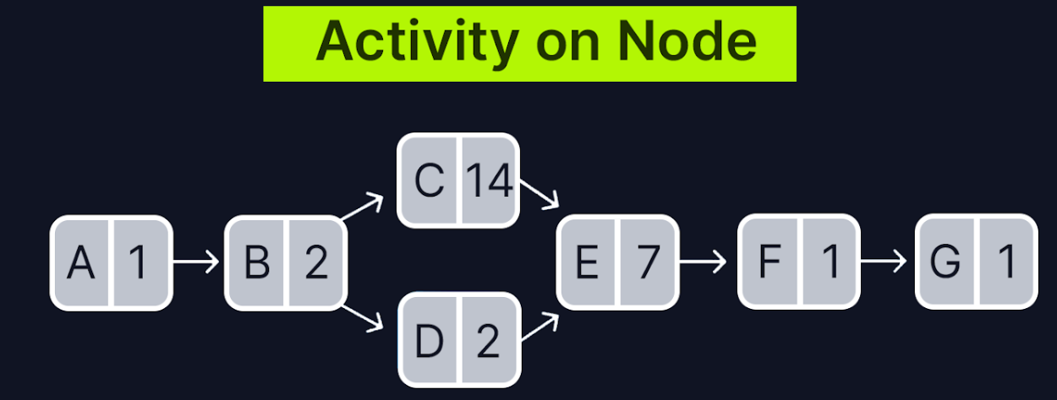

Slide 84
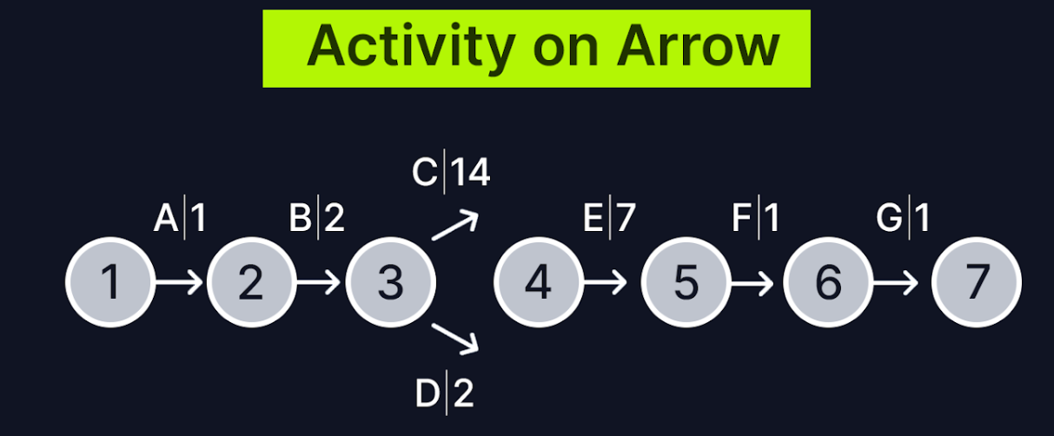

Slide 85
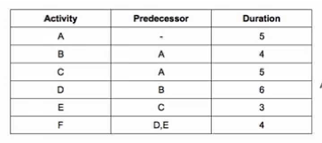
Realize the activity network and apply forward pass, backward pass and critical path

